Slide 1
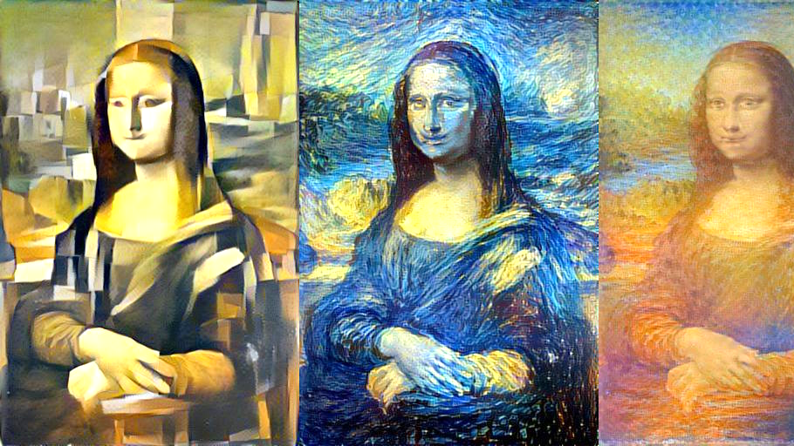

IMAGE STYLE TRANSFER
Yashasvi Jariwala
Jhanvi Shah
Andrews Tito
Mona Lisa restyled by Picasso, Van Gogh, and Monet
Image source: http://genekogan.com/works/style-transfer

Slide 2
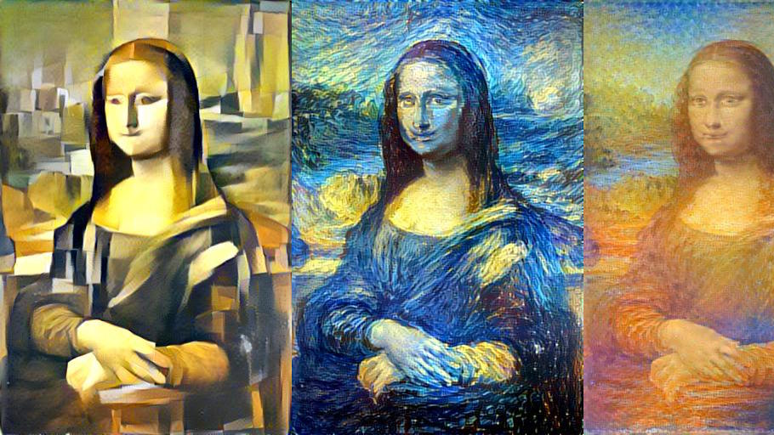
What is our research project ?
Image Style Transfer
Remember using applications like Prisma, Snapseed, Lucid etc. ?
Ever wondered how these things works?
Give a photo from our camera roll, select a design to combine both the images and we get a resultant new image which has the content of our input image and style of the design image. In the world of deep learning this is called “Style transfer”
The style of a painting is: the way the painter used brush strokes; how these strokes form objects; texture of objects; color palette used.
The content of the image is what objects are present in this image (person, face, dog, eyes, etc.) and their relationships in space.
Note : We are tweaking an existing algorithm and validating an existing algorithm

Slide 3
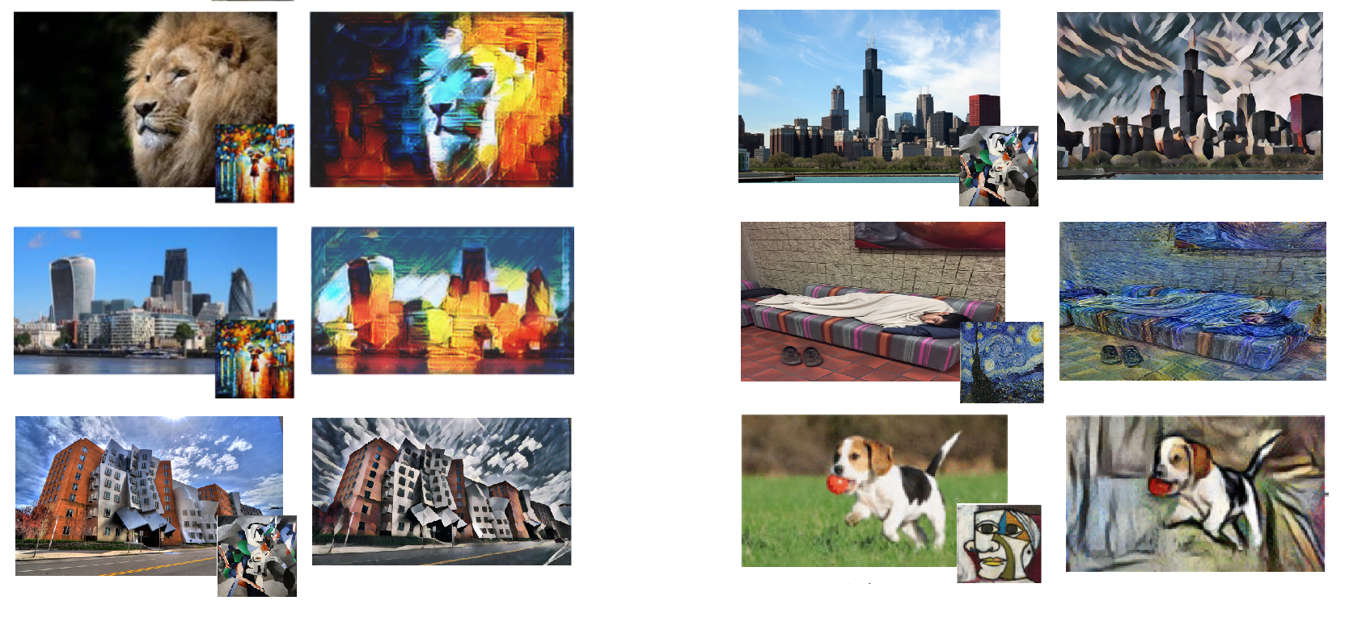
Examples

Slide 4
What papers is the research based on?
Gatys' A Neural Algorithm of Artistic Style,
Johnson's Perceptual Losses for Real-Time Style Transfer and Super-Resolution,
Vincent Dumoulin’s A Learned Representation For Artistic Style,
Note: Perceptual Losses for Real-Time Style Transfer and Super-Resolution can stylize images hundreds of times faster than the optimization-based method presented by Gatys et al

Slide 5
What are the requirements?
Pre-trained VGG19 network
VGG19 – a 19 weight layer network, is trained on a subset of the ImageNet database, which consists of more than a million images and can classify images into many object categories. (Developed and trained by Oxford's renowned Visual Geometry Group)
TensorFlow (v 1.9.0)
Numpy & Scipy
Pillow or PIL (Python Imaging Library) – library for image manipulation

Slide 6
How do we separate style and content of an image?
By using convolutional neural networks(CNNs)
Wiki defn. a convolutional neural network (CNN) is a class of deep, feed-forward artificial neural networks, most commonly applied to analyzing visual imagery. CNNs use a variation of multilayer perceptrons designed to require minimal preprocessing. They were inspired by biological process, namely the connectivity pattern between neurons resembles the organization of the animal visual cortex.
- filters in the first layers in CNNs recognize simple patterns, brush strokes, textures, etc.
- filters in the intermediate layers happen to locate and recognize major objects in the image, such as a dog, a building or a mountain.
Note: If we take a convolutional neural network that has already been trained to recognize objects within images then that network will have developed some internal independent representations of the content and style contained within a given image.
In a VGG net, shallow layers learns low level features and as we go deeper into the network these convolutional layers are able to represent much larger scale features

Slide 7
How much work has been done ?
Implemented Gatys neural algorithm of artistic style
Ran iterations on the already trained VGG19 network to obtain resultant images.
Ran iterations with default hyperparameters as specified by the papers
(Code will be shown)

Slide 8
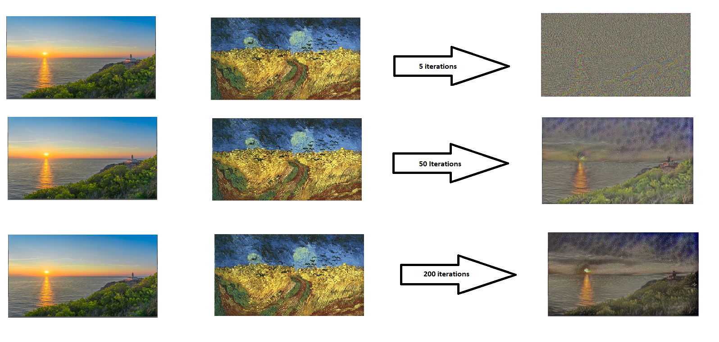
How much work has been done (output) ?

Slide 9
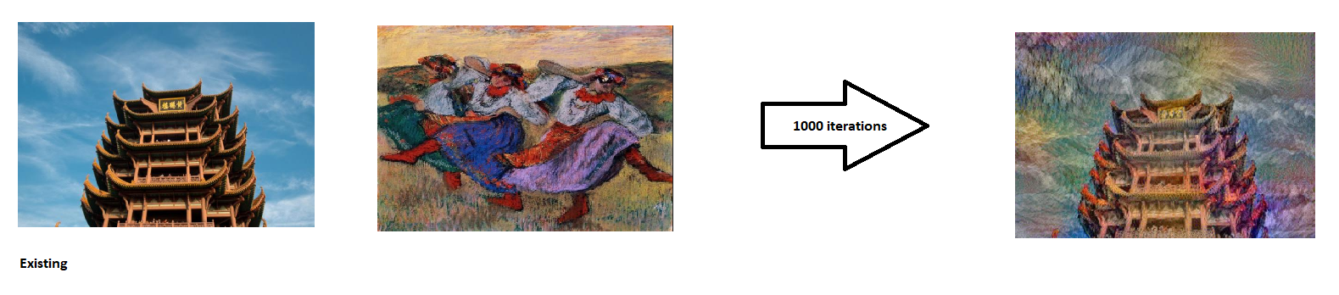
How much work has been done (output) ?

Slide 10
What still needs to be done ?
- Hyperparameter tuning (mainly content-weight, style-weight)
content-weight : amount of image in the resultant image reconstruction
style-weight : amount of style image in the resultant image
Improving the quality of the generated image
1. Making output images smoother
Tuning the tv_weight parameter
2. Choosing optimum style layer and content layers
3. Modifying the loss network to improve convergence
by replacing max pooling with avg pooling decreases time taken iterate. (max pool in general tends to have finer detail style transfer, but could have troubles at lower-freqency detail level)
(Original VGG topology uses max pooling, but the paper suggests replacing it with average pooling.)
- Improving training times
- 1. Down-sample the training image (640x480 to 256x256)
- It decreases the training time by drastically and can easily be used for finding the optimal network architecture

Slide 11
What problems have been encountered ?
Lack of a GPU enabled system
training taking a longer time (1000 iterations took 3 hours on a CPU driven iteration)
Lower iterations (say around less than 1000) does not produce an identifiable resultant image.
- Memory dumps while running larger iterations
- TensorFlow compatibility with python version on Jupyter notebooks

Slide 12
Future Scope ?
Deep photo style transfer (style from one photo to another)
Video style transfer (resultant video would have a style derived from an image

Slide 13
Thank You

